Slide 1
From Bachelors degree (Akure, Nigeria) to MPhil (Cambridge) and PhD candidacy in Cambridge
Ademola Aiyenuro
Research Assistant/PhD candidate
Department of Pathology,
University of Cambridge
aea46@cam.ac.uk

Slide 2
Undergraduate: 2012 - 2017
Learning
Interests
Volunteering
Post - Undergraduate: 2017 - 2020
Internship/work experience
Laboratory scientist/Public health officer
Volunteering
Publication/peer reviews
MPhil: 2020 - 2021
Research assistant: 2021 - 2022
PhD: 2022 - 2025

Slide 3
Time management
Utility
Meaningful activities
Time for everything
Discipline
Dedication

Slide 4
Consistency
P-push
U-until
S-something
H-happens

Slide 5
Community Development Services
Networking
Professional and career foundation
A strong and relevant profile
Events: conferences, workshops, trainings

Slide 6
An impactful community development service/volunteering
A 365 days campaign against drug abuse in Nigeria
1st January, 2019 – 31st December, 2019

Slide 7
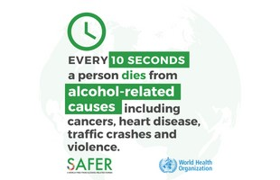
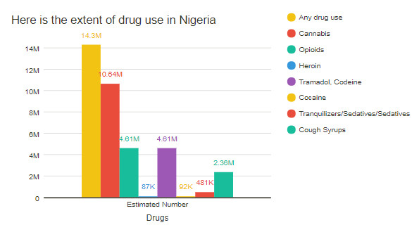
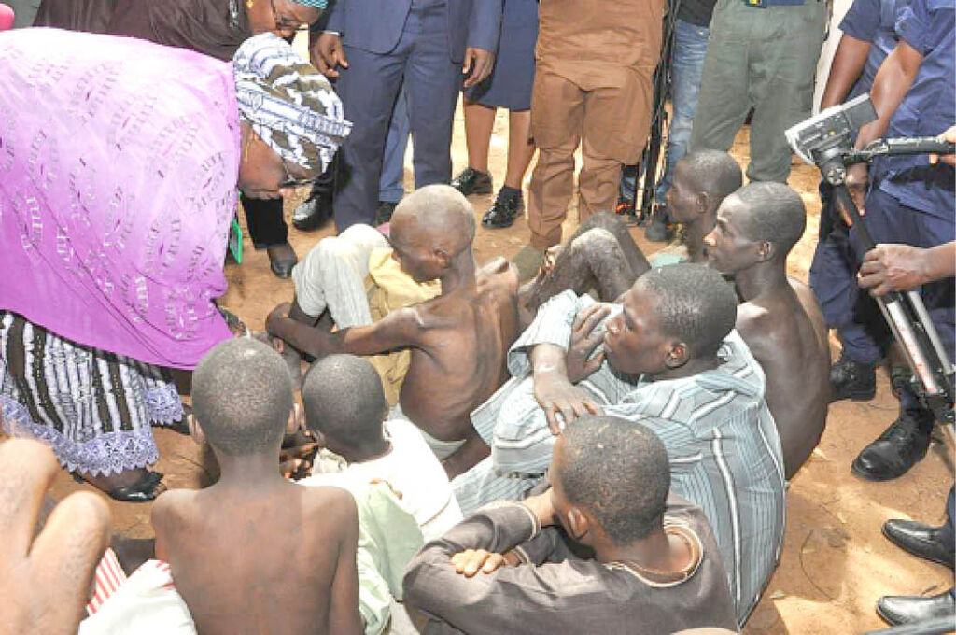
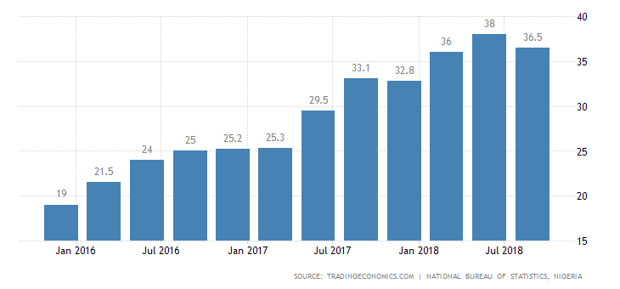
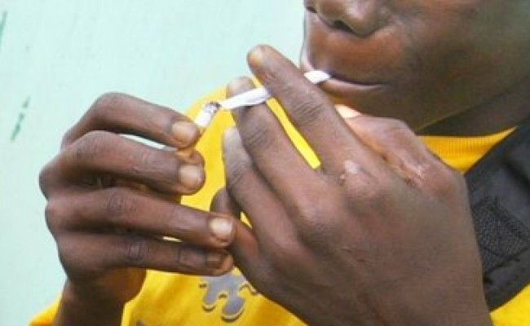
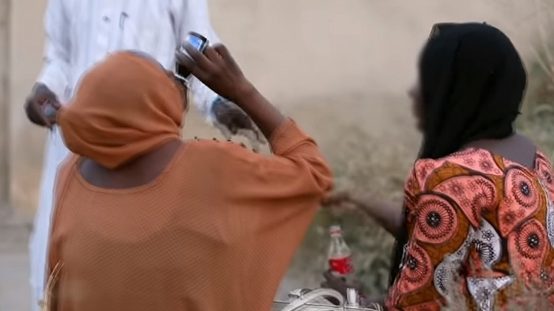
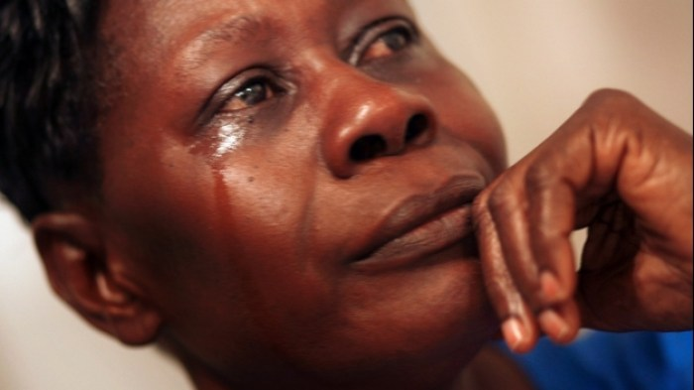


DEATHS | MOBIDITY
LOW ACCESS TO REHABILITATION CENTERS
INCREASE DRUG USERS
PROBLEM STATEMENT
UNEMPLOYMENT
TEENAGERS AND DRUGS
WOMEN AND DRUGS
FAMILY CONFLICT

Slide 8
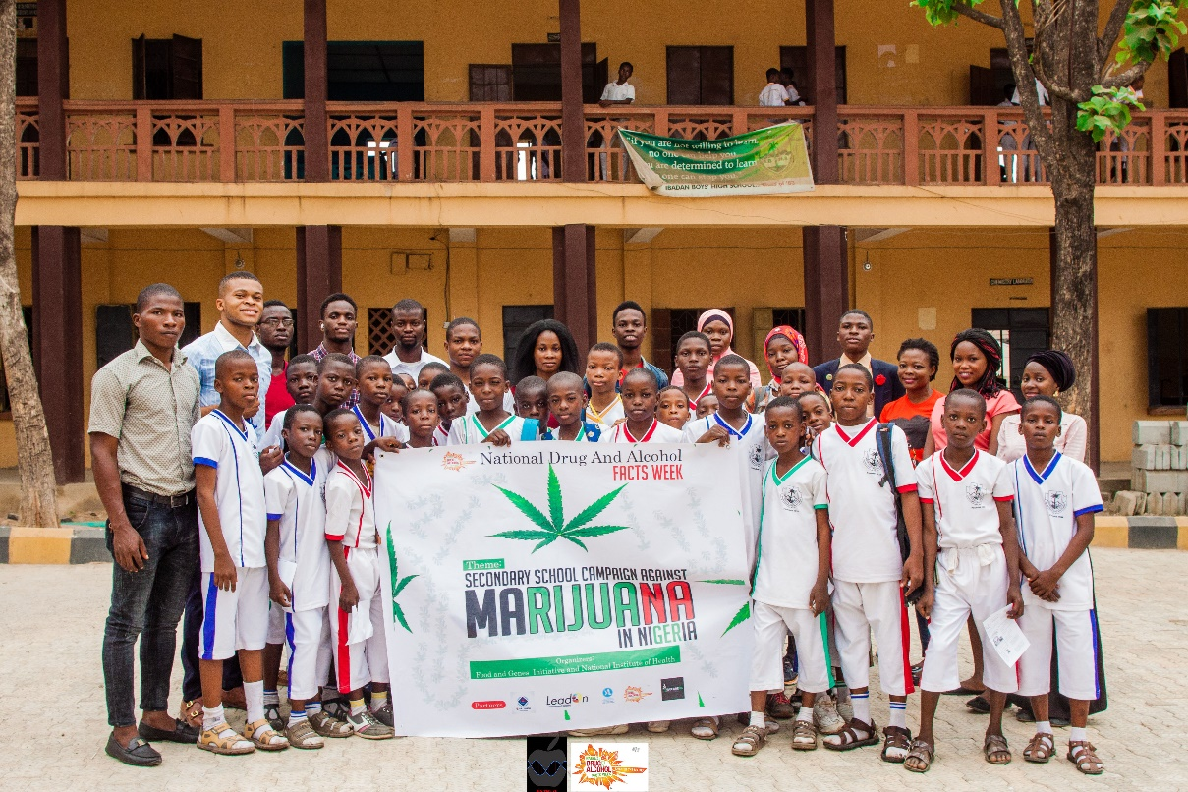
“THEORY OF CHANGE”
If we can provide awareness on drug abuse, tobacco use and alcoholism and provide accessibility to rehab centers for drug addicts, we hope to reduce non communicable diseases, family conflicts, criminality and lack of productivity in Nigeria.

Slide 9




THE SOLUTION
DAYS
ONLINE
PROGRAM
OFFLINE
PROGRAM
Drug Abuse Youth Sensitization
OBJECTIVES
AWARENESS
ADVOCACY
ACCESSIBILITY TO REHABS
ACTION-ORIENTED PROGRAMS

Slide 10
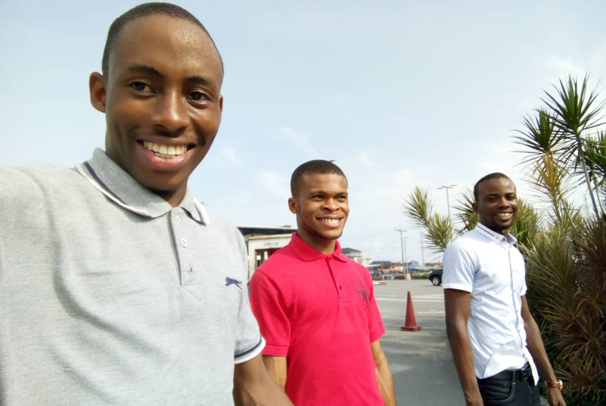
Mentorship

Slide 11
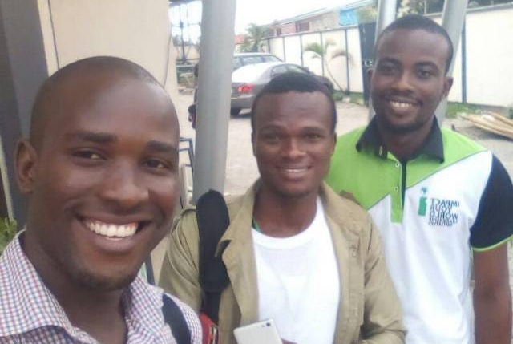
Networking

Slide 12
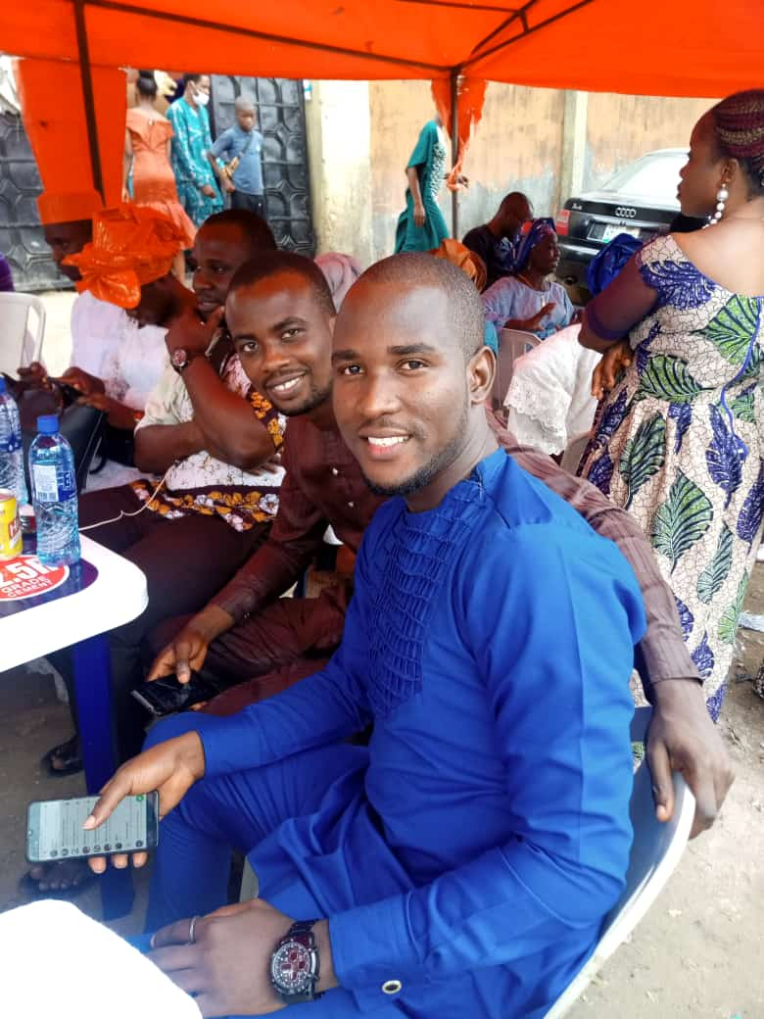
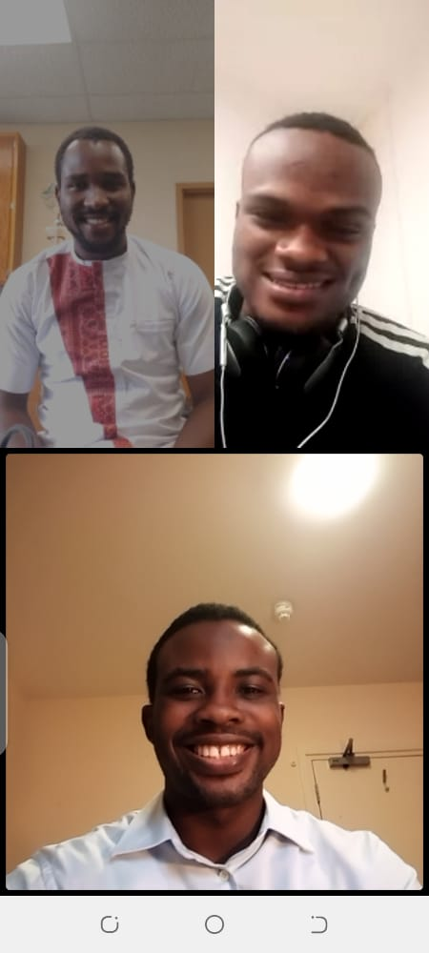
Peer to peer ambitions-Goals achieved?

Slide 13
Social media
Linkedln
Twitter
Facebook

Slide 14
Thank you
For
listening

